Slide 1
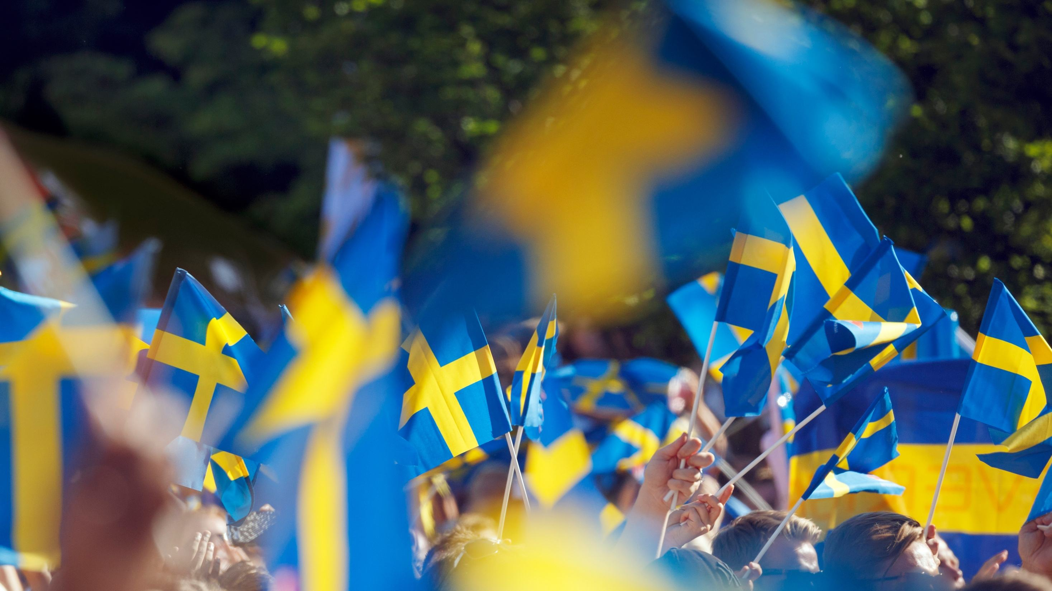
Sweden
Smarter Together
Photo: Ola Ericson / Imagebank.sweden.se
Notes:
Note to user: This slideshow is meant to be used as a guiding frame for your presentation. Feel free to pick the slides you wish to use and add your personal touch to it where it suits your context and purpose. Also feel free to add your own intro and your own words as you speak – the speaking points are meant as support rather than a literal script.
Refer to sweden.se for additional facts and sharingsweden.com for relevant reports.
The image of Sweden abroad - Sharing Sweden

Slide 2
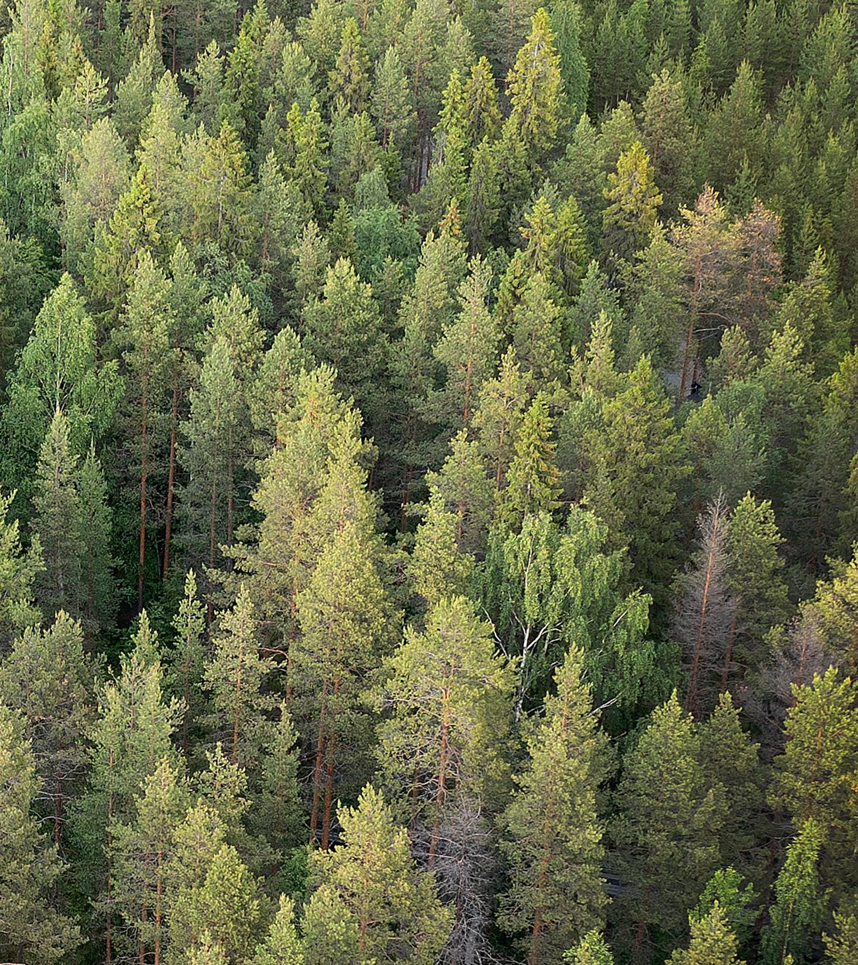
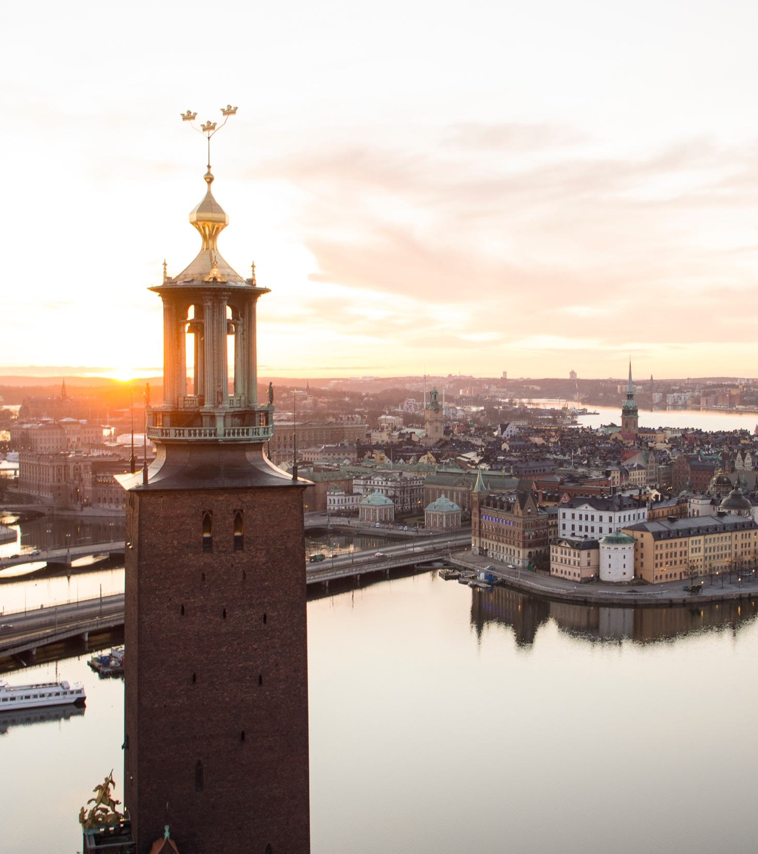

450,000 km²
To roam
10 M
Sweden one of Europe’s least densely populated countries
Photo: Per Lundström / Imagebank.sweden.se
Photo: Björn Olin/Folio / Imagebank.sweden.se
Notes:
Most of Sweden is forest of spruce and pine. You may occasionally run into a moose while picking berries and mushrooms.
Only 10 million people live here.
The capital is Stockholm.
Sweden is a monarchy, although it is governed with parliamentary democracy.
Most importantly: Sweden is a nation shaped by freedom and progress – shared progress!
Sweden is all about being smarter together. And that means including people. Including you

Slide 3
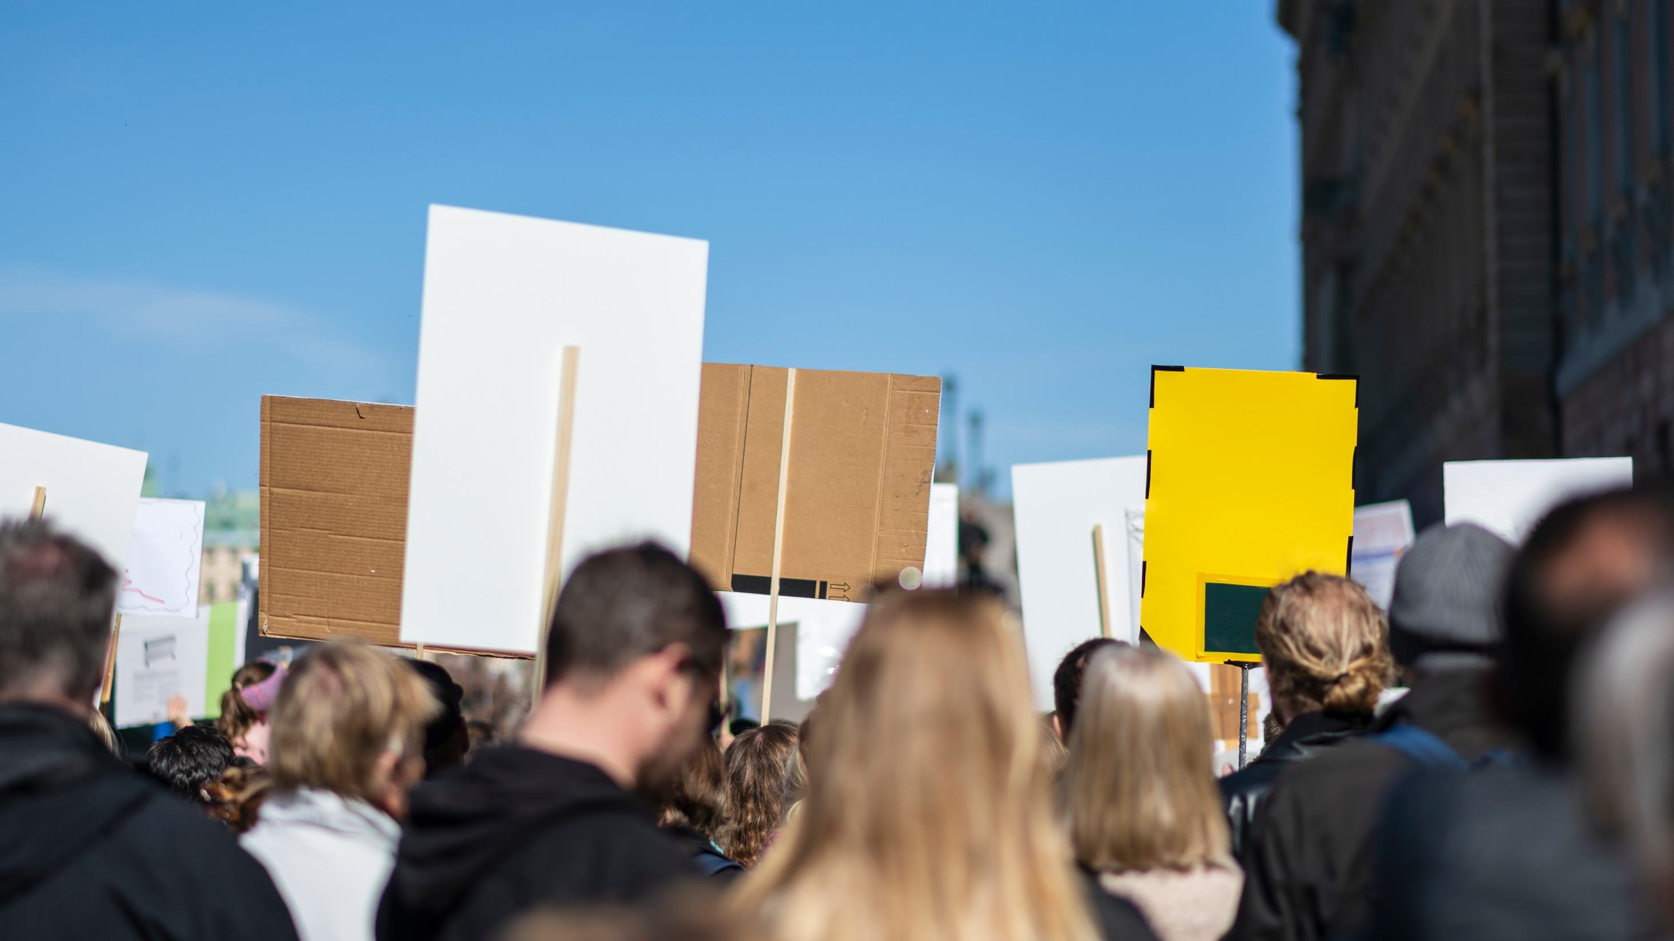
When everybody can speak their mind, anything becomes possible.
Top 5
Democracies globally
Photo: Jens Lindström / Johnér / Imagebank.sweden.se
Notes:
Progress needs openness, security and critical thinking.
In 1766, Sweden was the first country in the world to write freedom of the press into law.
Today, Sweden ranks among the top democracies in the Varieties of Democracy and Global Democracy indexes.
Sweden is a society deeply rooted democratic governance.

Slide 4

Innovative thinking often starts small. Very small.
Photo: Maskot / Johnér / Imagebank.sweden.se
Notes:
Societies that respect the individual early on, create independent thinkers.
In Sweden, children’s autonomy, safety and voice is protected from an early age. This way, Sweden builds confidence, curiosity and a willingness to question.
Sweden was one of the first countries to recognise children as rights-holders.
Corporal punishment was banned in 1979 – first in the world!

Slide 5
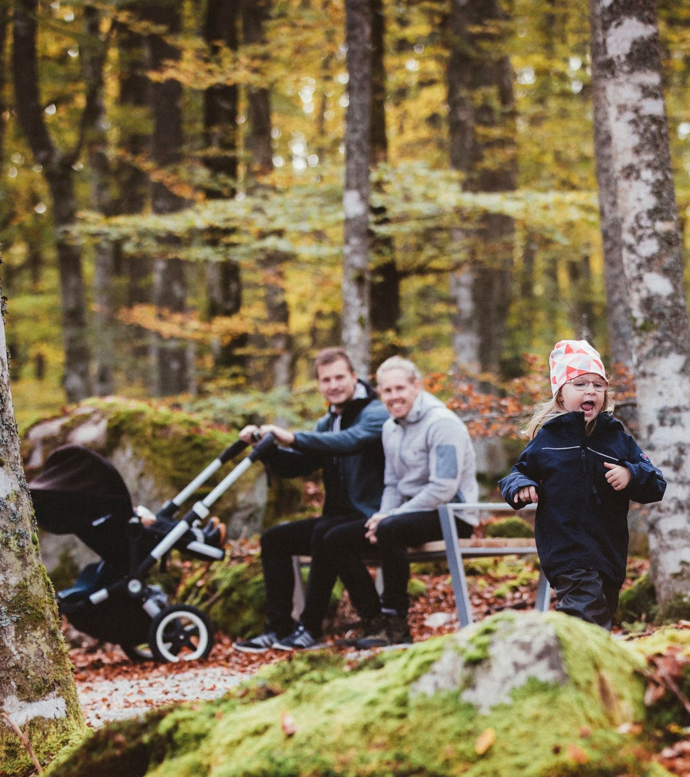
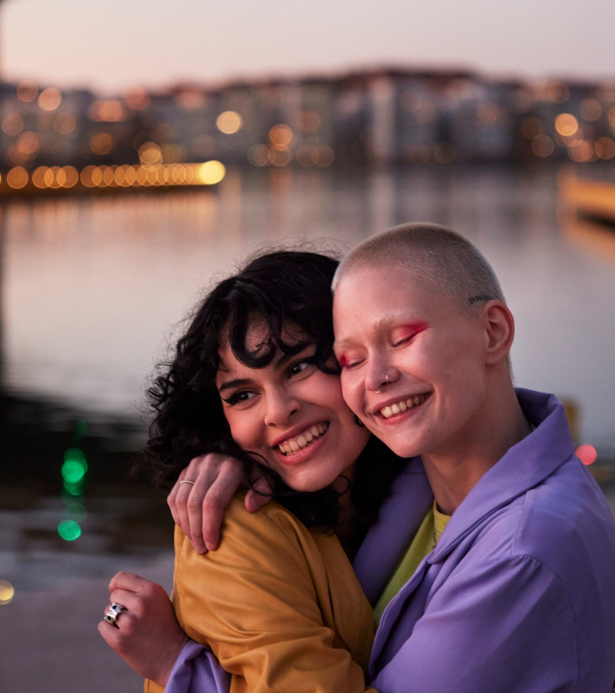
Equality is built into the system. And we keep on building.
1974
#1
First in the world with shared parental leave
Best country for working women
Photo: Alexander Hall / Imagebank.sweden.se
Photo: Plattform / Johnér / Imagebank.sweden.se
Notes:
1974, Sweden was the first country in the world to introduce shared parental leave – one of many aspects that boil down to equality.
Sweden has a long tradition of strengthening democracy and equal rights. Women gained the right to vote in 1921. Today, gender-neutral marriage and the law on sexual consent continue to shift from principle to practice.
According to The Economist Group Glass Ceiling Index, Sweden claimed the top spot as the best place to be a working woman in 2025.
Protection of equal rights has also extended, across gender, ethnicity, religion, disability, sexual orientation and age. Workplace discrimination is regulated by the Discrimination Act (2008:567), prohibiting employers from subjecting employees, job applicants, hired personnel, or interns to disadvantage or harassment, and requiring employers to actively work towards equal rights.
Sweden remains one of the world’s most equal societies.

Slide 6

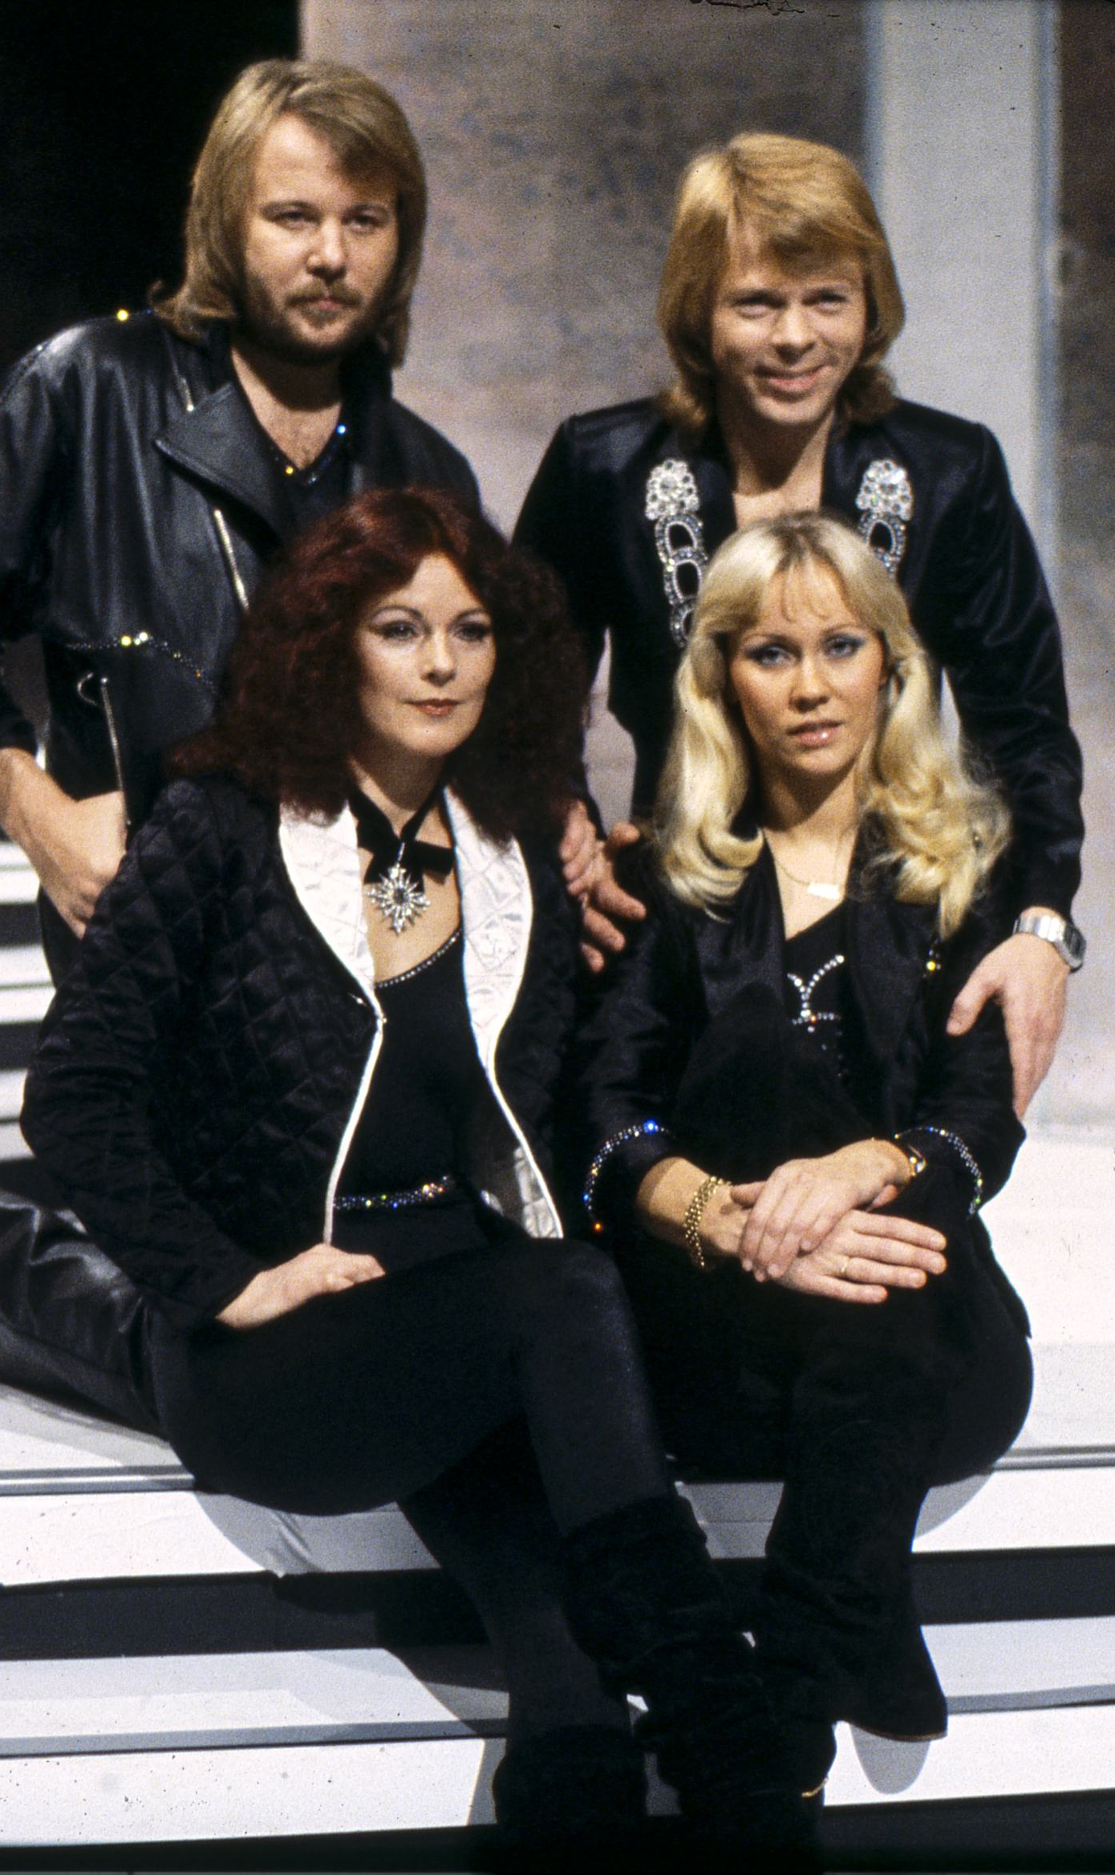
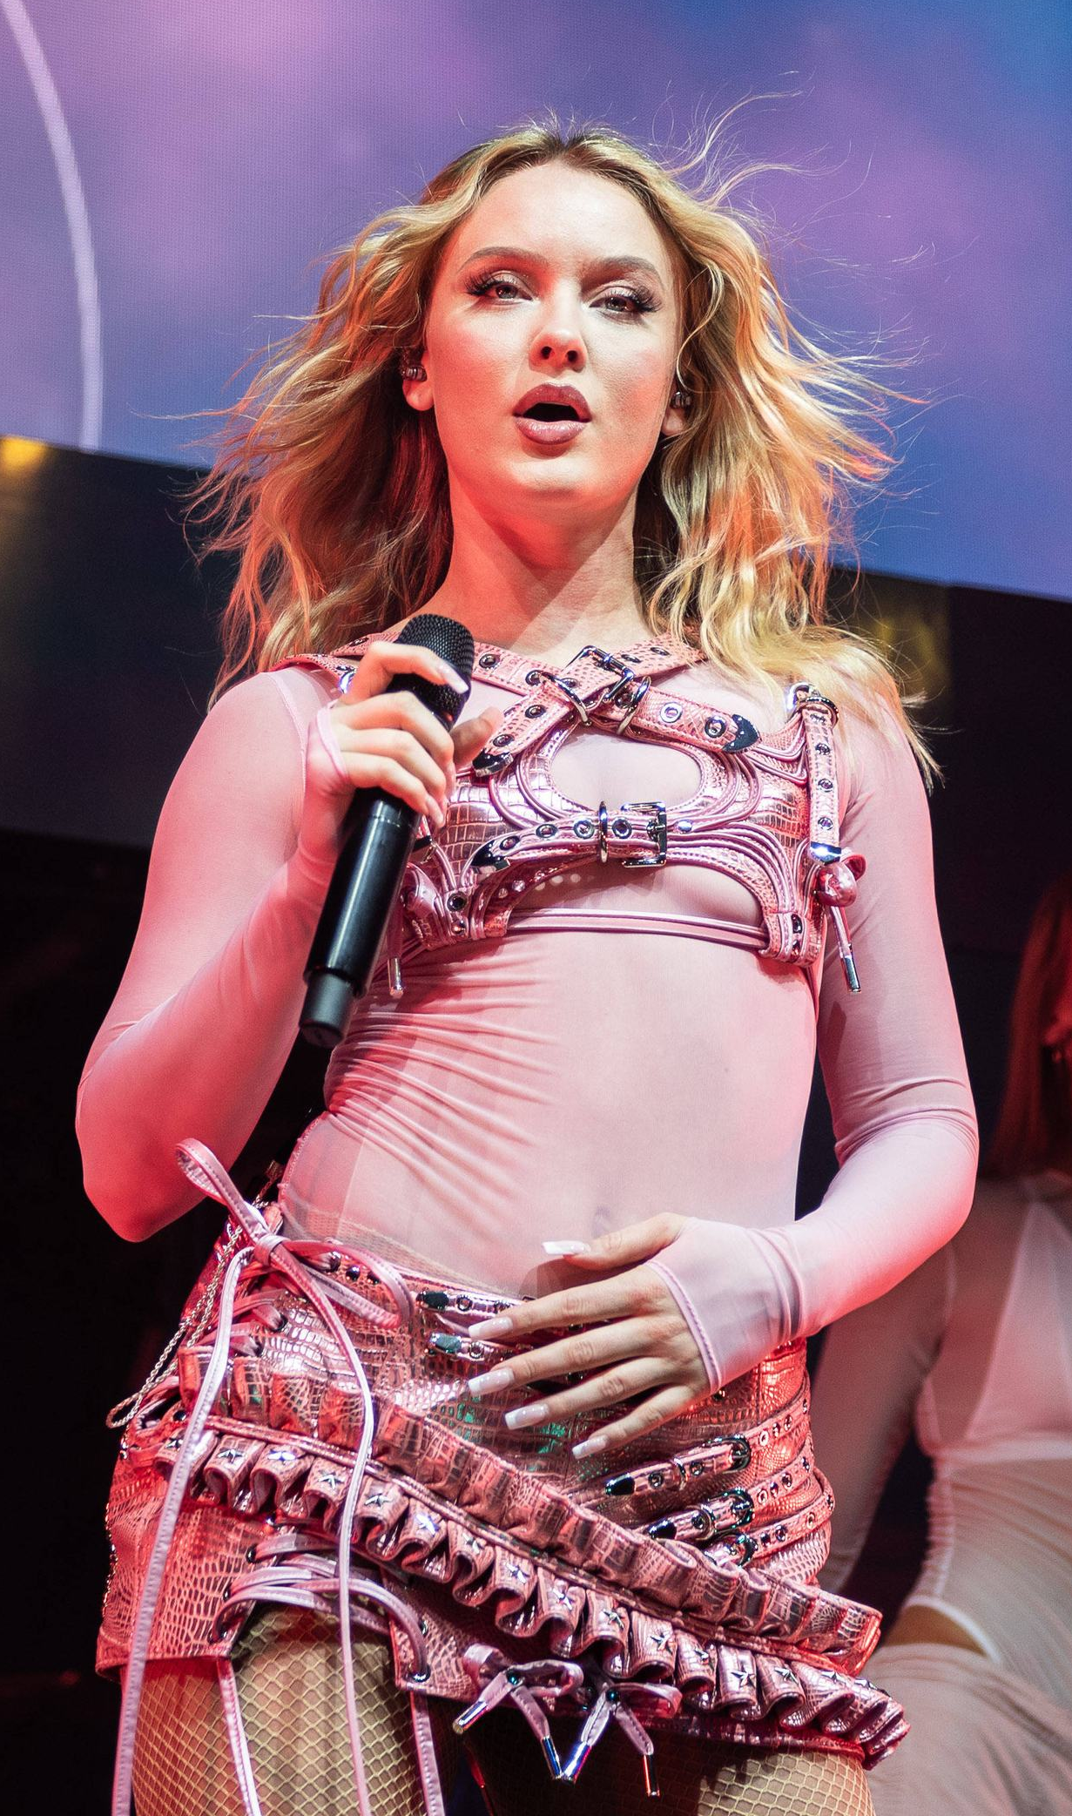
The small country with the world’s greatest hits.
Top 4
music exporters alongside the US, the UK and South Korea.
Photo: Fredrik Nystedt / Rockfoto / Imagebank.sweden.se
Photo: Svenskt Pressfoto / TT
Photo: Mirko Fava / TT
Notes:
All Swedes grow up learning English from an early age with equal access to publicly funded arts education and networks. Like Culture School (Kulturskolan), where young talent gets early structure in their creative ambitions.
Maybe that's why Sweden, a country of ten million people, has become a global pop leader.
Sweden is one of the few nations exporting more music than it imports alongside the US, UK and South Korea, – making it a clear net exporter, and the only country in the EU to hold that position. (Source: STIM)
Artists and producers from ABBA to Zara Larsson, First Aid Kit, Cazzi Opeia, Max Martin and Tove Lo are some examples. (choose or add names relevant for local country)

Slide 7
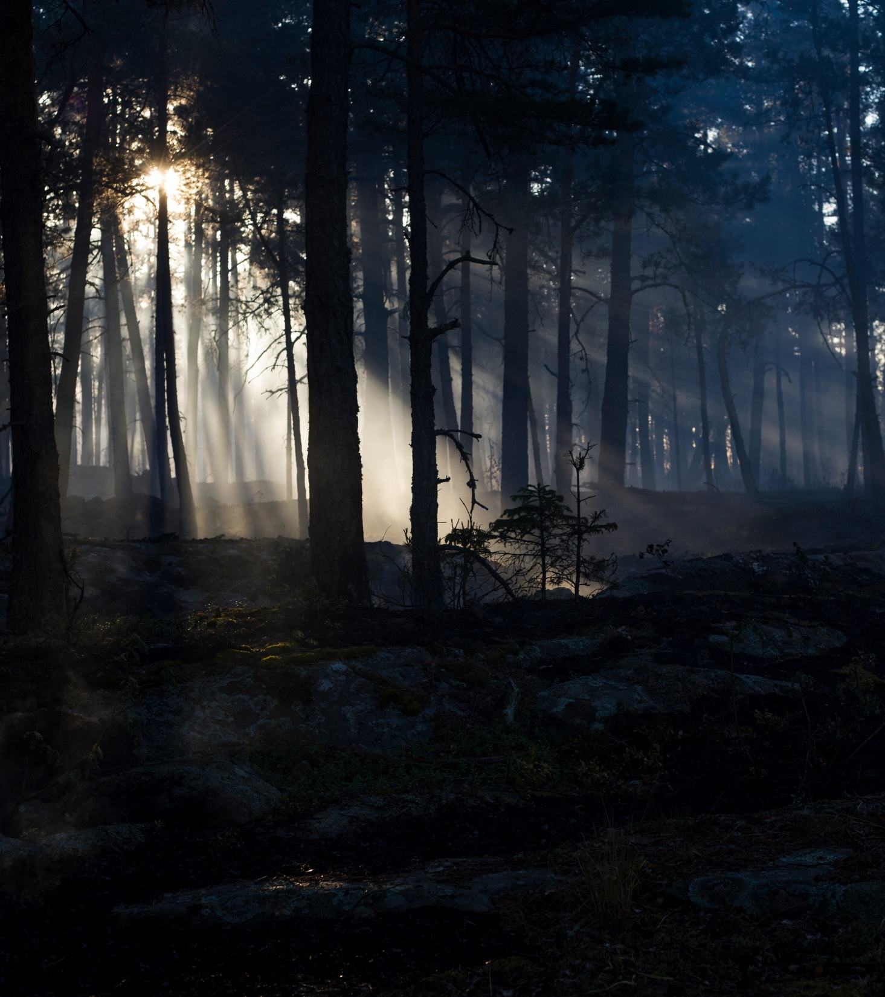
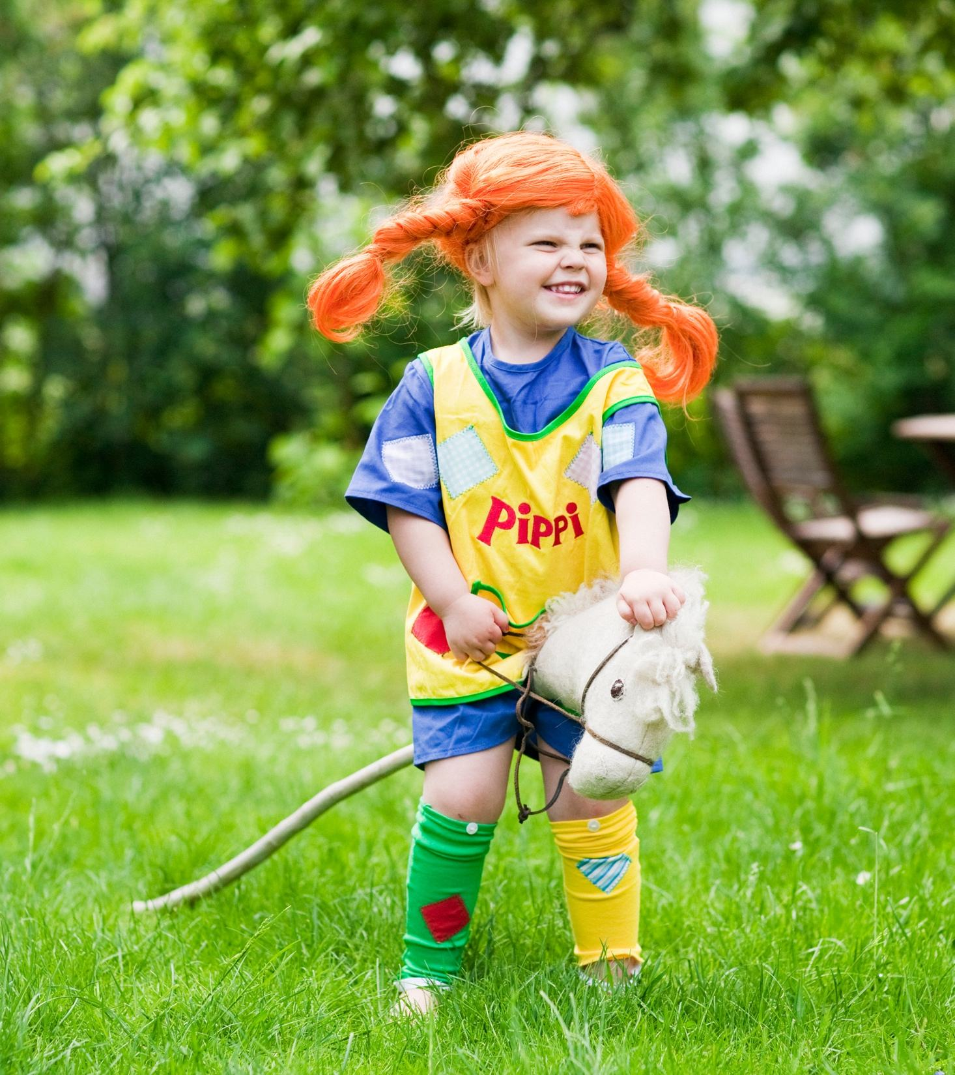
If you’re comfortable with discomfort, you’ll feel right at home.
Photo: Anders Tedeholm / Imagebank.sweden.se
Photo: Lena Granefelt/ Imagebank.sweden.se
Notes:
You probably know the stories about Pippi Longstocking by Astrid Lindgren. Or directors like Ingmar Bergman. And perhaps movies like The Girl with the Dragon Tattoo.
Sweden is known for storytelling that really provokes. Stories that confront complexity, discomfort and moral tension.
This creative legacy carries on. Through the many authors of Nordic Noir for example. Or through filmmakers and actors such as Ruben Östlund / Josephine Bornebusch / Tarik Saleh / Alicia Vikander / and the Skarsgård family. (mention international film projects or locally popular Swedish productions)

Slide 8
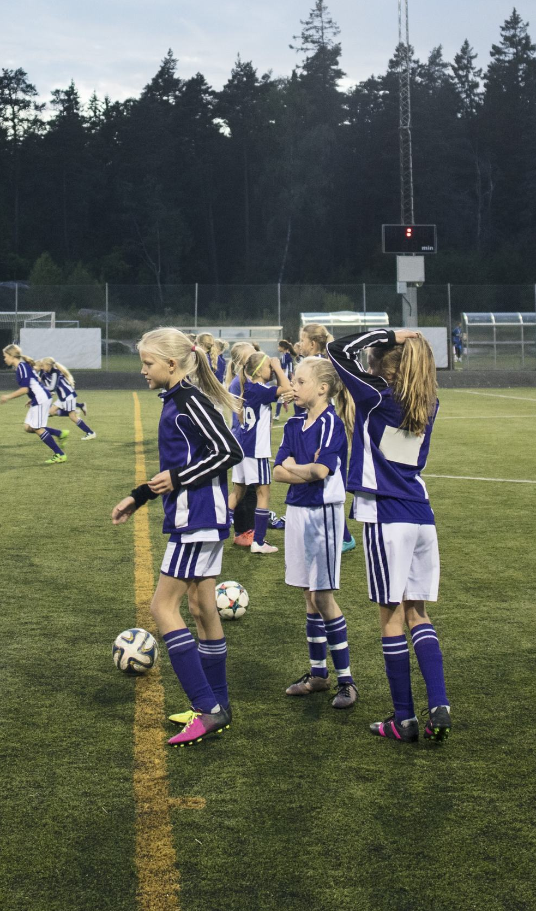
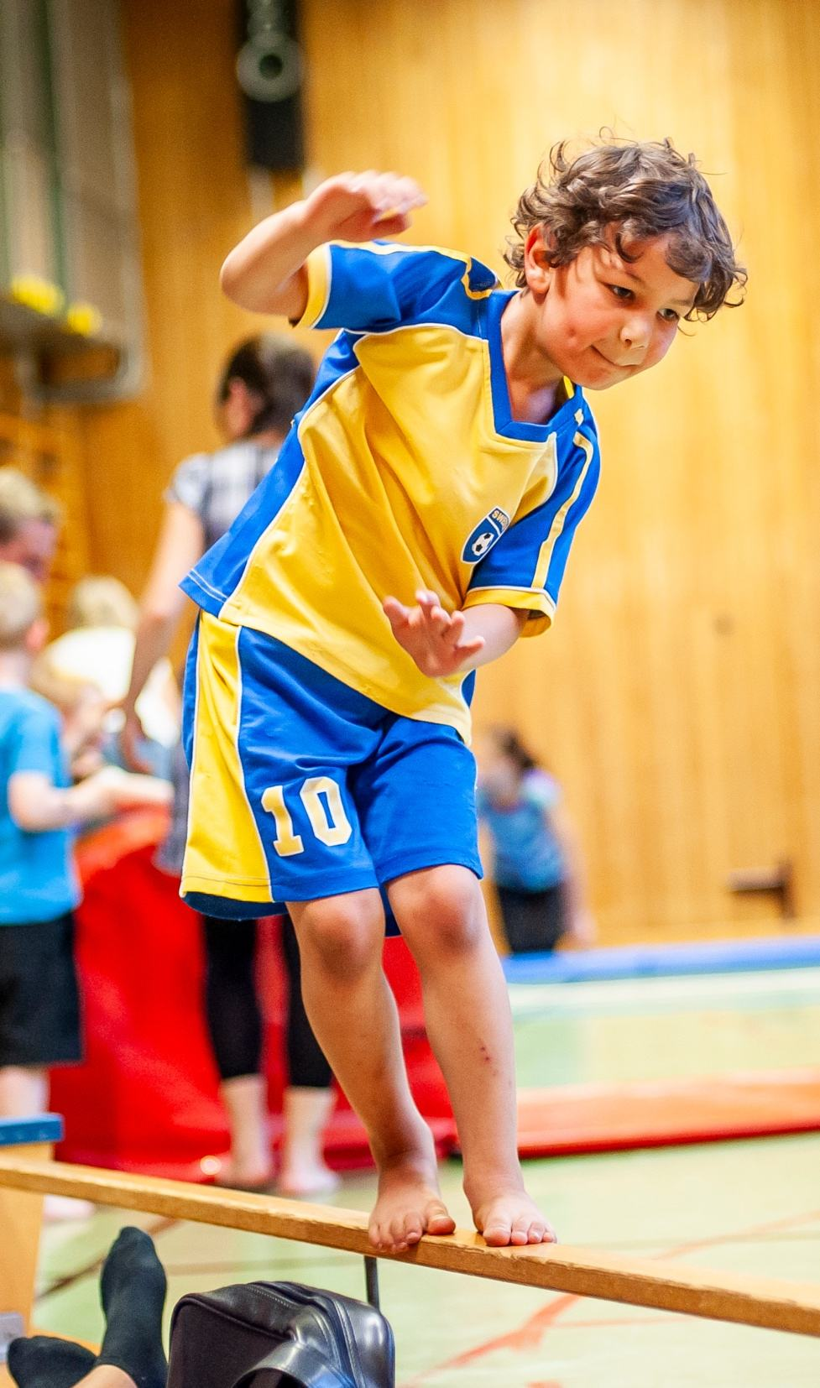
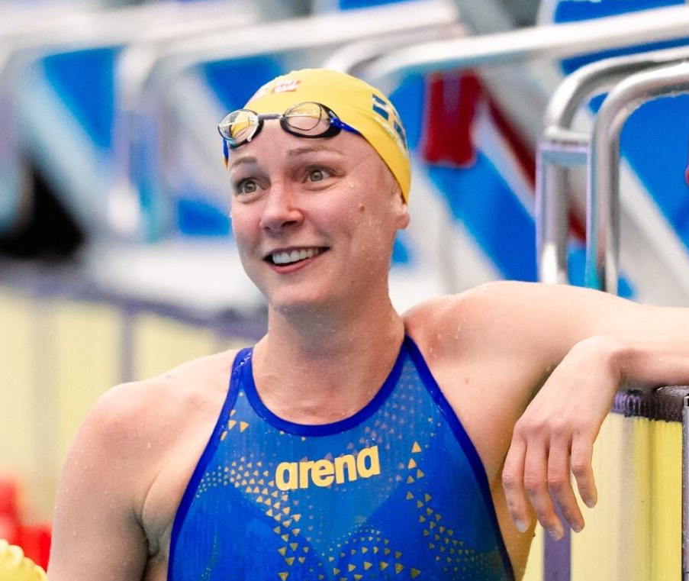
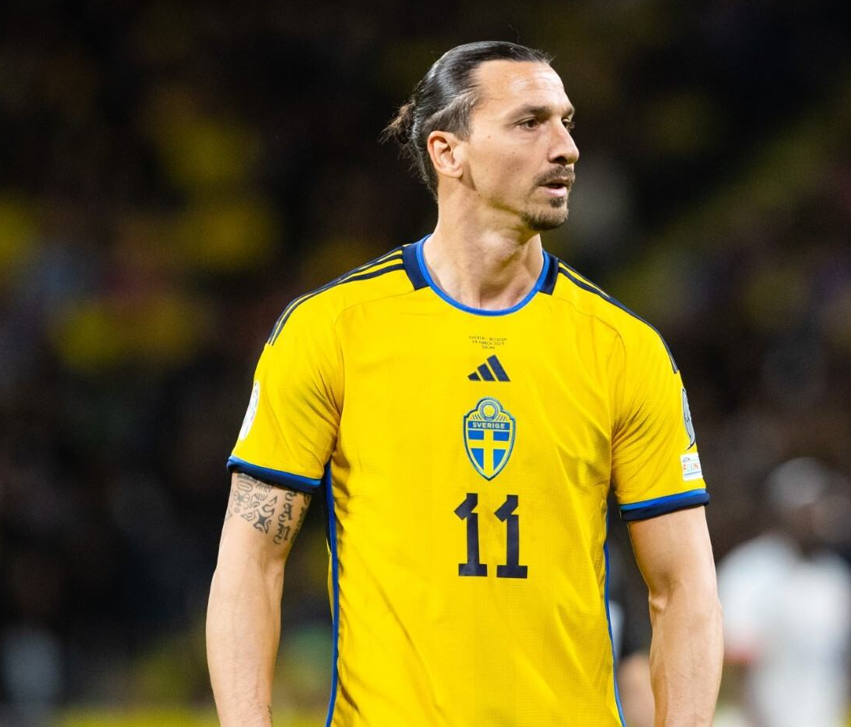
A sporting nation built for the long game.
Photo: Simon Hastegård / Bildbyrån
1/3
is a member of a sports association
Photo: Maskot / Johnér / Imagebank.sweden.se
Photo: Alexander Mahmoud / Imagebank.sweden.se
Photo: Tobias Sterner / Bildbyrån
Notes:
Swedish sport is born out of local clubs where every kid is invited and every parent can help. 1 out of 3 swedes is a member of a local sports association as active competitors, trainers, referees, keep fitters or supporters.(Carreer Sweden 2023)
This has brought about some global celebrities you may know about. Like Zlatan Ibrahimović, Sara Sjöström and Armand Duplantis. (mention relevant names and leave out others)

Slide 9

1/4
1,000
has played a Swedish-made game
Companies in the gaming industry
Photo: Elliot Elliot / Imagebank.sweden.se
Notes:
One out of four has played a Swedish made game. (Sharing Sweden) E-games are big in Sweden too. Both in terms of gaming tournaments and software development.
Games like Minecraft, Candy Crush Saga and Toca Boca are also a huge part of the Swedish export industry.

Slide 10
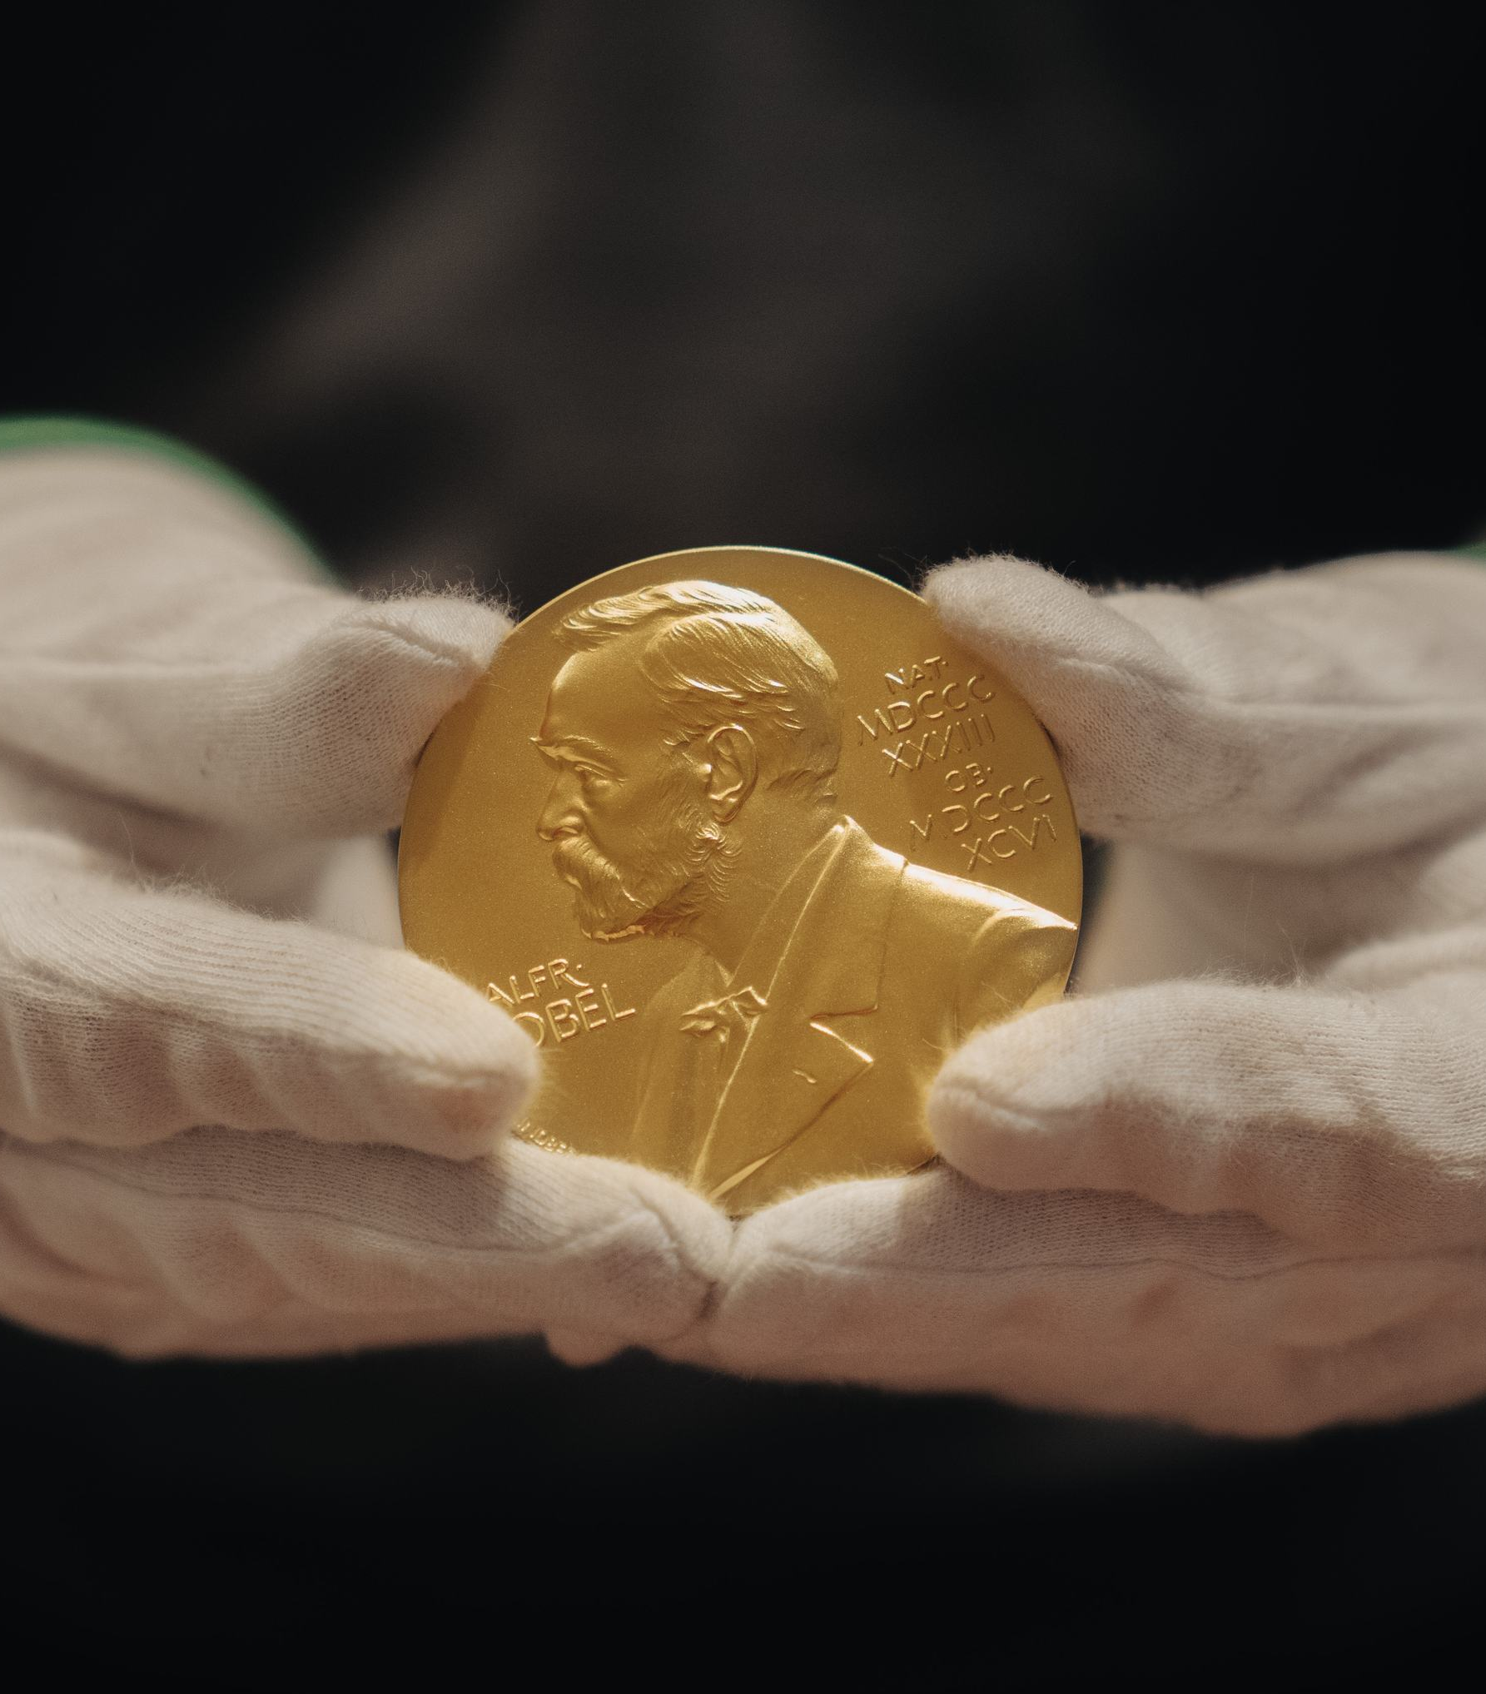
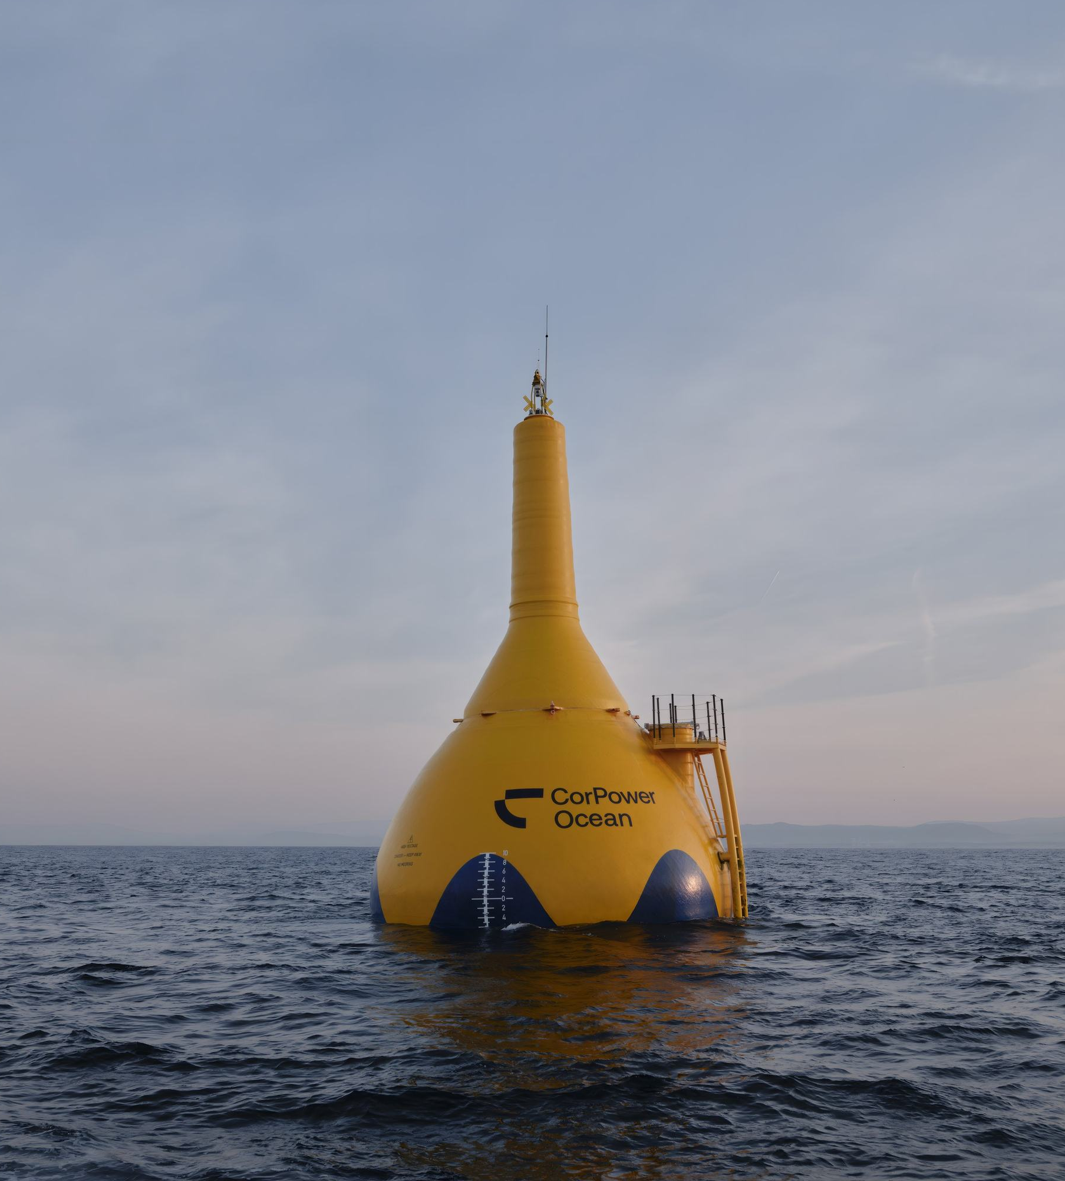
We love explosive solutions that go global.
90%
By 2045
hydro, solar, wind and nuclear power
the goal for Sweden is to have 100 per cent low-carbon electricity
Photo: Clément Morin / Imagebank.sweden.se
Photo: CorPower Ocean
Notes:
Big problems demand bold solutions and collaborative innovation across nations. Like expanding fossil free energy systems to meet the climate challenge. Or responsible mining of critical minerals
and rare earth elements.
The inventor of dynamite, Alfred Nobel, embraced this philosophy when he established the Nobel Prize, honouring the discoveries that bring the greatest benefit to humankind.
Today, the same approach powers Sweden’s software and AI economy. The country is a net exporter of unicorns and home to the EU’s leading start-up ecosystem. It also ranks among the world’s top six inno-
vation economies.

Slide 11
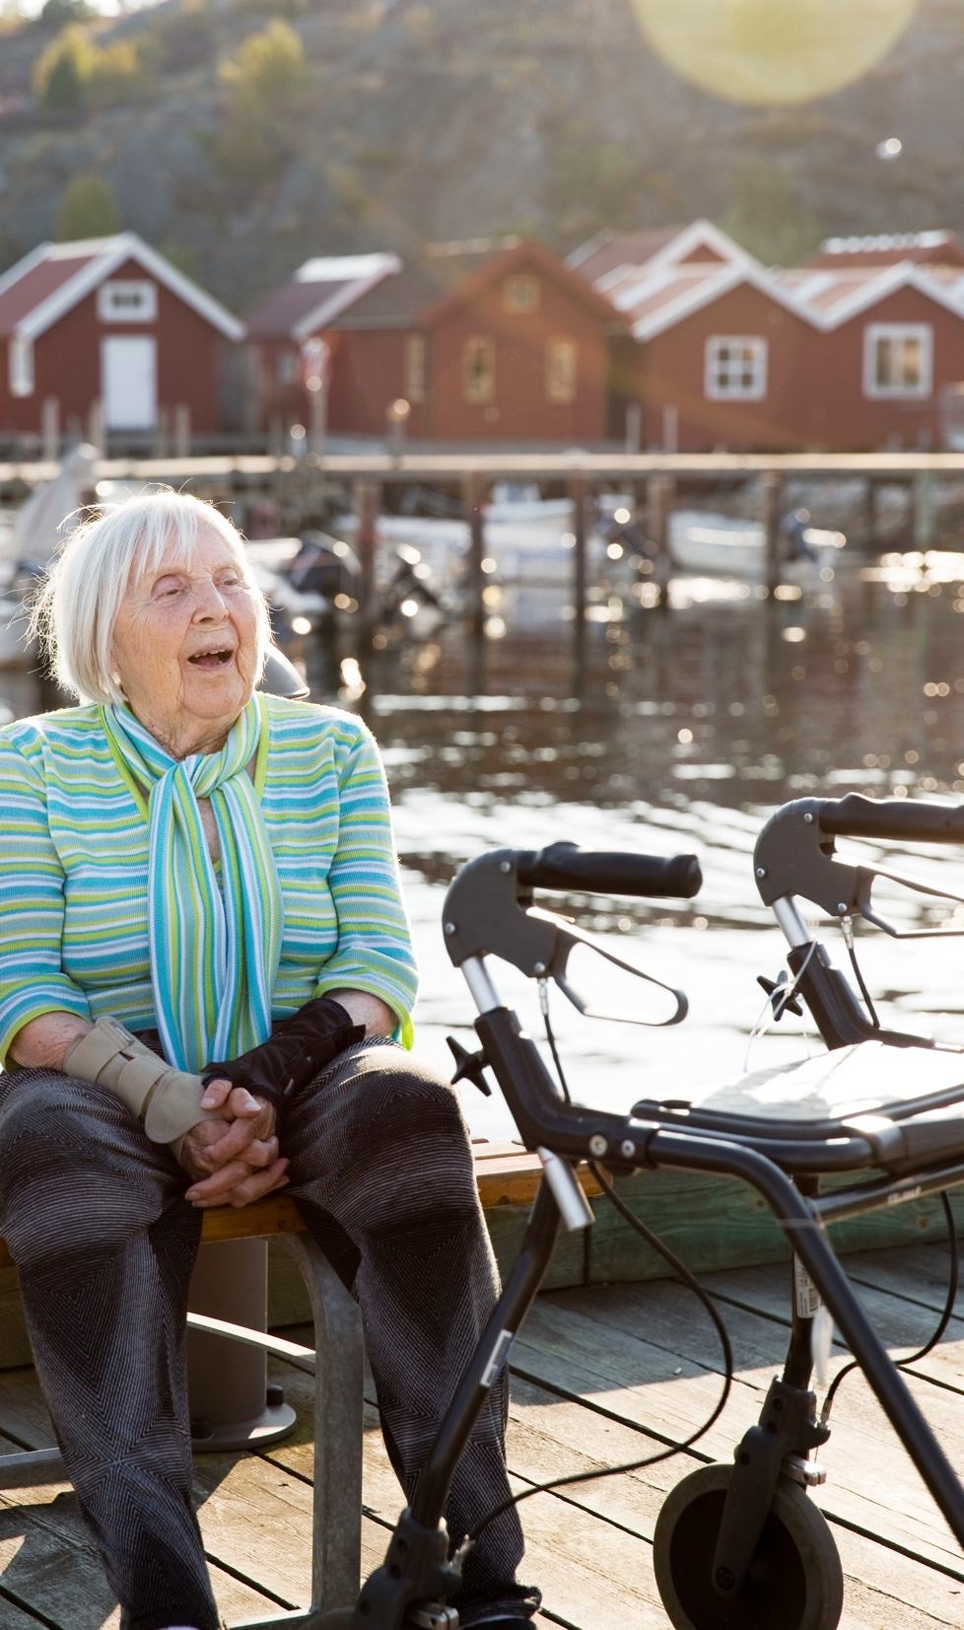
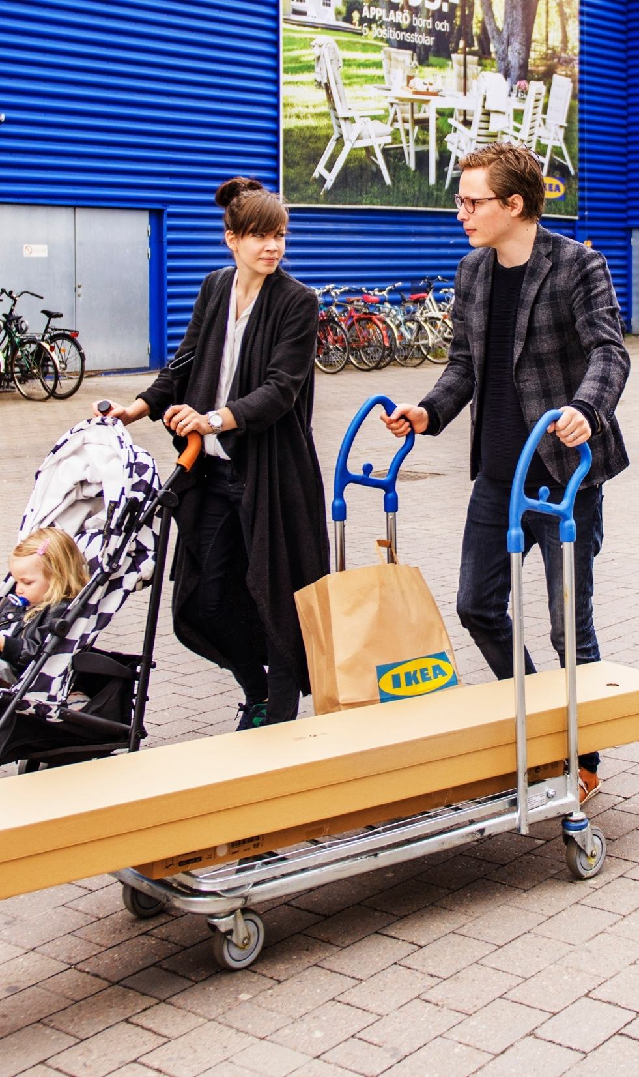

Our hearts literally beat for solving real-life problems.
Photo: Lena Öritsland / Johnér / Imagebank.sweden.se
Photo: Simon Paulin / Imagebank.sweden.se
Photo: Amanda Westerbom / Imagebank.sweden.se
Notes:
Sweden is home to classic innovations such as pacemaker, a medical innovation that transformed cardiac care. The zip fastener. Or the flat, affordable IKEA furniture pack,
Sweden is also home to modern innovations that makes life easier. Like AI-solutions helping with administrative tasks and safety functions.
This problem-solving approach sums up the theme of this short introduction quite nicely.
Come to think of it, what's there not to like about being smarter together? (Mention a local example of collaboration)

Slide 12





Thank you!
sharingsweden.se
Sweden
Sweden
Sweden

Slide 13
Thank you!

